Slide 1
Designing Multi-Agent Systems
Challenges and Pitfalls
Donald Thompson
Distinguished Engineer
Microsoft

Slide 2
What is an agent
An AI agent is an autonomous system powered by (language) models that achieves goals by:
Reasoning: Using LLM capabilities for logical thinking
Planning: Creating multi-step strategies
Acting: Executing tools/APIs to effect change
Observing: Monitoring outcomes and environment
Self-Correcting: Adapting strategy based on feedback
Key differentiator: autonomy - agents maintain self-directed control over their process, dynamically adjusting their approach rather than following scripted paths.

Slide 3
What is a multi-agent system
A multi-agent system consists of two or more autonomous agents that collaborate (cooperative or adversarial) to achieve goals through:
message passing (distributed)
direct invocation (local)
shared memory (blackboard)
environment modification (state)

Slide 4
Why not a single agent?
Almost everything marketed as "multi-agent" could be done with a single agent. Multi-agent is primarily a software engineering choice, not an architectural requirement.
What Single Agents Can Do:
Switch between different prompts/modes (adversarial validation, different expertise)
Call different models via tool use (GPT-4 for reasoning, Claude for coding)
Manage complex workflows with state machines
Handle "parallel" tasks through async operations

Slide 5
When to use multi-agent systems?
Hard Requirements for Multi-Agent
Physical parallelism with latency constraints - When you MUST process in multiple locations simultaneously (edge computing, geographic distribution)
Regulatory/security boundaries - When different parts of the system need different data access, compliance rules, or security clearances
Organizational boundaries - When different teams/companies need to deploy and manage their agents independently
Why We Choose Multi-Agent Anyway (Engineering Benefits)
Team scalability - Different teams own different agents
Deployment flexibility - Update one agent without touching others
Prompt maintainability - Focused prompts are easier than mega-prompts
Testing isolation - Test each agent independently
Failure boundaries - Bugs in one agent don't break everything
Mental model clarity - Easier to reason about specialized components

Slide 6
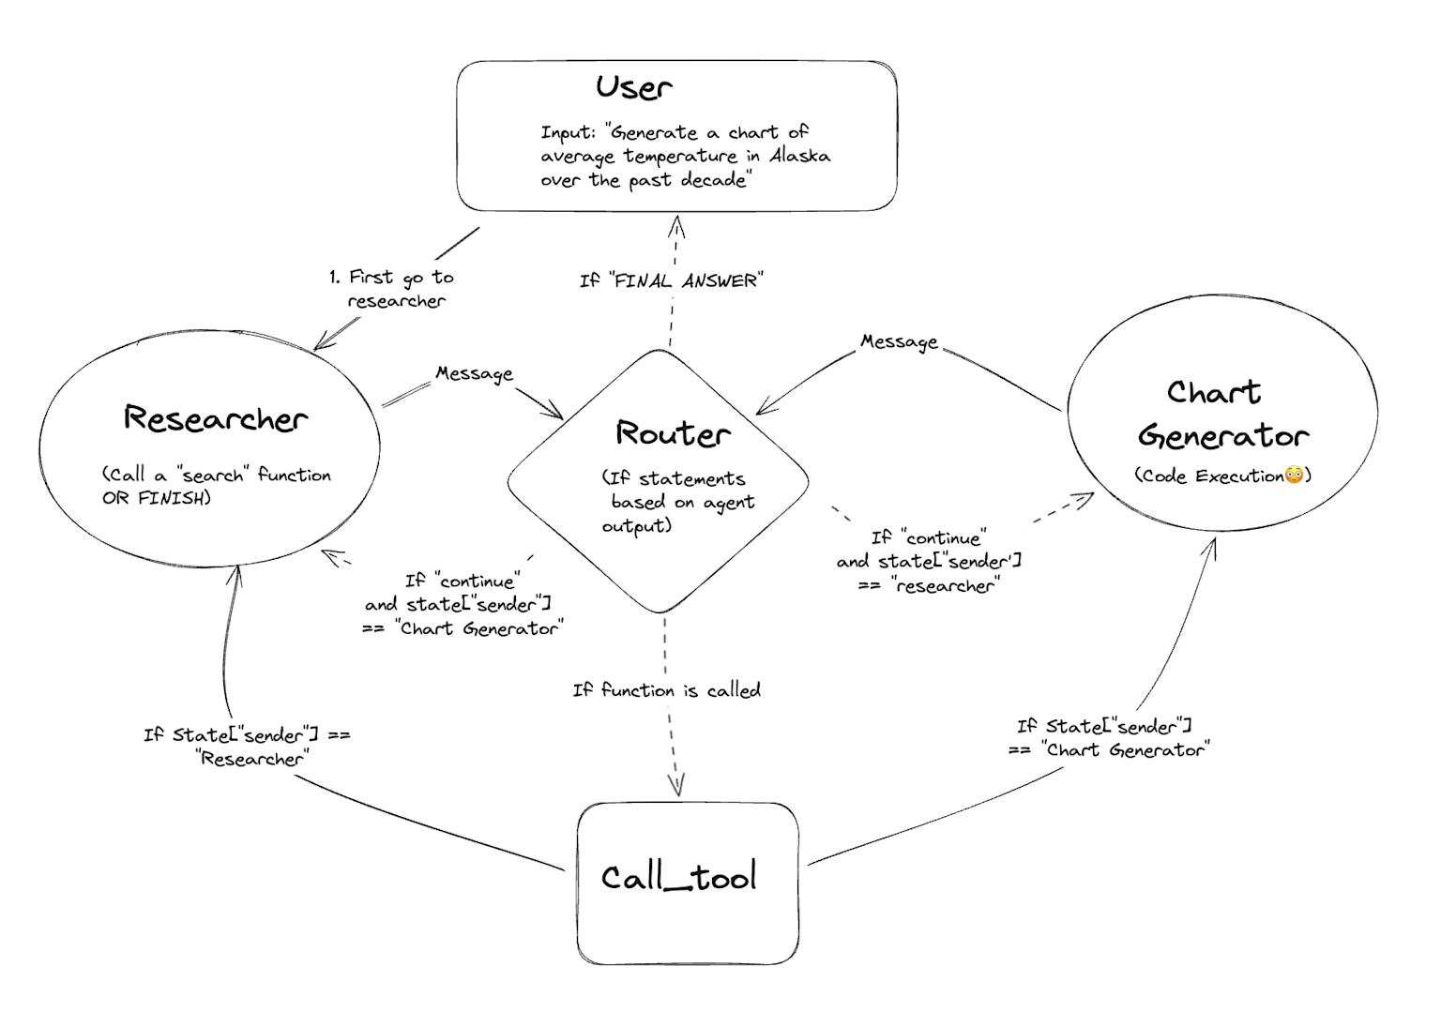

Slide 7
